Slide 1

NETFLIX DATA ANALYSIS
PUCHE
MENTORED BY: ASHISH RAJPUT

Slide 2
CONTENTS
INTRODUCTION
OBJECTIVES
BUSINESS PROBLEMS
PYTHON ANALYSIS
TABLEAU ANALYSIS
CONCLUSION.

Slide 3
introduction
In the ever-evolving landscape of entertainment, data analytics plays a pivotal role in understanding viewer behavior and shaping content strategies. This project delves into the realm of Netflix, employing the powerful combination of Python and Tableau to extract, analyze, and visualize data. By exploring viewer preferences, content performance, and engagement metrics, this endeavor aims to provide a nuanced understanding of the streaming dynamics, ultimately contributing valuable insights to enhance the Netflix viewing experience and inform strategic decisions in the competitive streaming industry.

Slide 4
Objectives
This project aims to explore user behavior, identify trends, and create visually compelling dashboards to provide actionable recommendations for content improvement and user engagement.
DATA SOURCE :KAGGLE
https://www.kaggle.com/datasets/victorsoeiro/netflix-tv-shows-and-movies?select=titles.csv

Slide 5


BUSINESS PROBLEMS
python
tableau
1. which year has the most number of movies released.
2.Display the count of movies in each type.
3.Top 10 movies with highest runtime
4.Find the number of movies have the imdb rating more than 8 in the year 2022`
5.Display the top 10 most voted movie and thier imdb score
6.Display the top 10 movie titles with highest imdb score
7. Is there any correlation between number of votes and score
8. Display the title of the movie with the most number of seasons
9. Display the title of the movie with the least number of seasons
10 Show the distribution of runtime
1.Display the Top 10 movies with the most number of actors.
2.Find the most popular character and the actor name .
3. Show the Age certification number of movies
4. Display the Trend in certification over the past years
5.Show the year wise genre trend with number of movies
6.Display the most popular genre wit respect to movies and shows.
7. Display the number of movies and show released yearwise.
8.Display the most producing countries in terms of movies and shows.
9.Find the trend of movies and shows in the past years.
10.Find genre popularity.

Slide 6


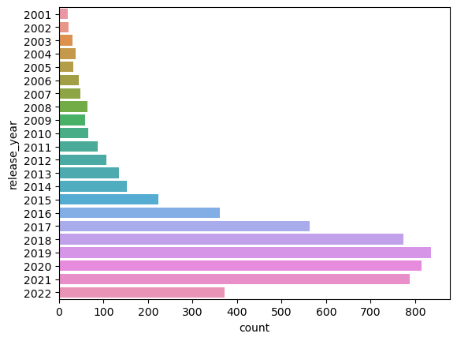
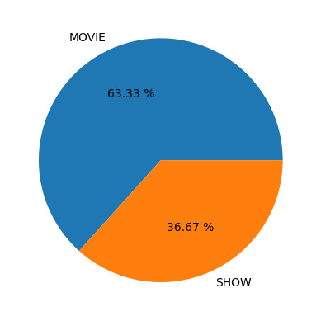
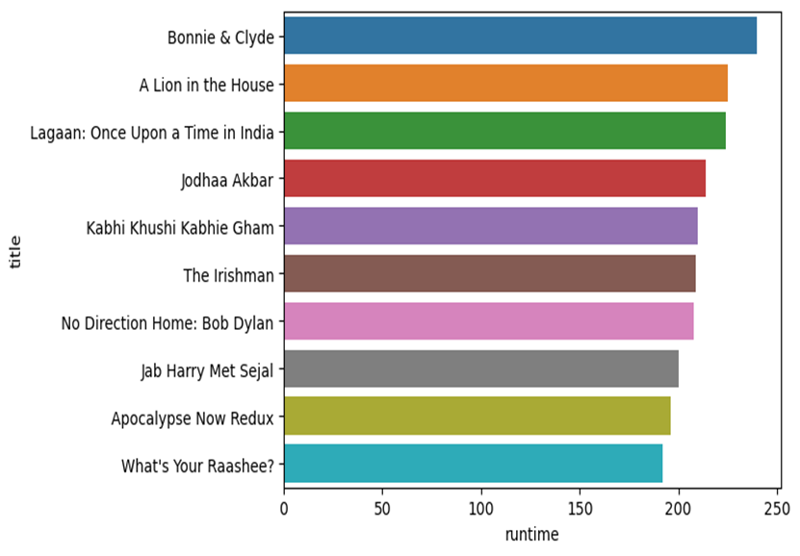
python
1.which year has the most number of movies released.
2.Display the distribution of movies and shows in each type.
3.Find the top 10 movies with highest runtime.
From observing the above graph,2019 has the most number of movies released with over 800 .
Movie is twice the number of shows
Respectively, movie(63.33%) and shows(36.67)
The resulted graph shows ,Bonnie and Cycle is the movie with the highest runtime

Slide 7

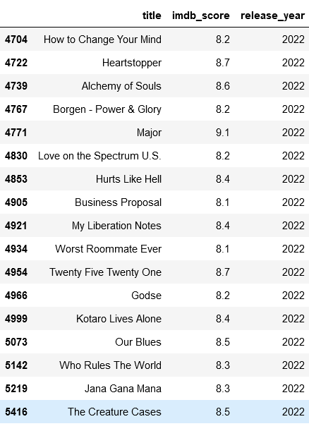
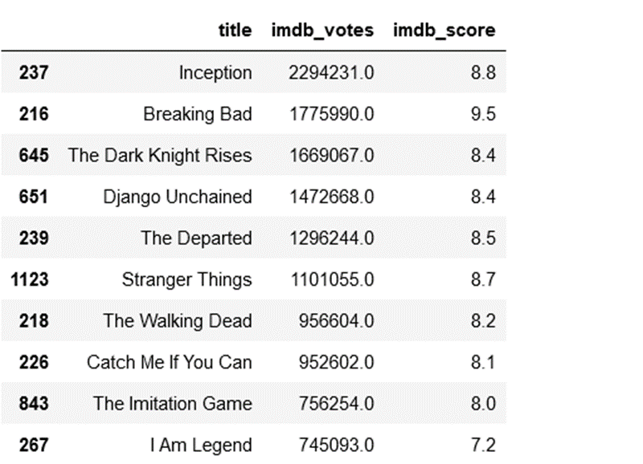
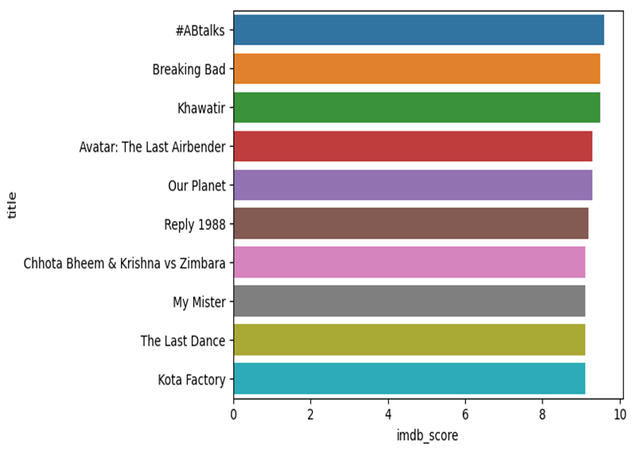
Python
4. Find the number of movies who have the imdb rating more than 8 in the year 2022`
5.Display the top 10 most voted movie and their imdb score.
6.Display the top 10 movie titles with highest imdb score..
Inception is the most voted movie with the
imdb score 8.8
but Breaking Bad has the highest imdb score 9.5
And is the second most voted movie.
#ABtalks has the most highest imdb score with Kota Factory as the least among the Top 10.
Out of the movies that got released in the year 2022, there are only 17 movies who crossed the imdb rating of 8.

Slide 8

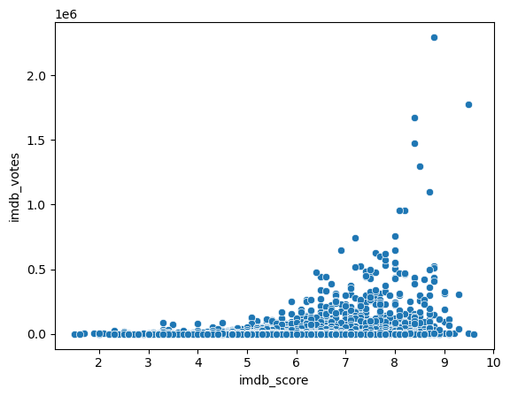
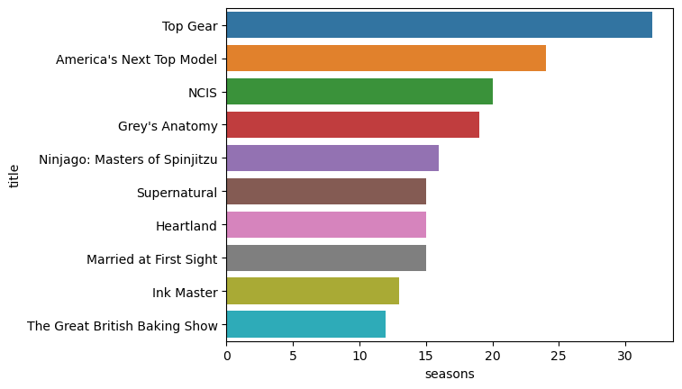
7.Is there any correlation between number of votes and score.
8. Display the title of the movie with the most number of seasons.
From the given fig we see that Higher imdb score have more votes.
Top Gear has the most number of seasons followed by America’s Next top Model .

Slide 9
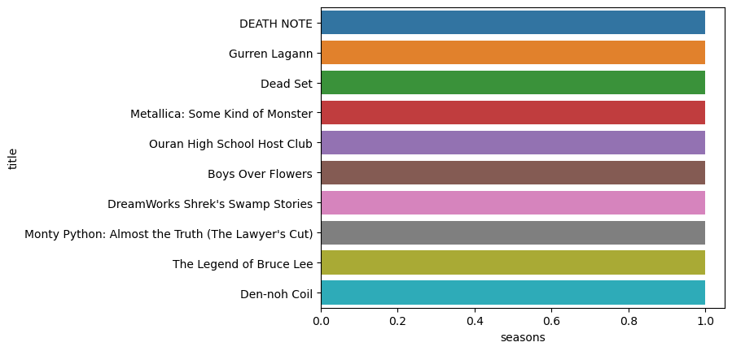
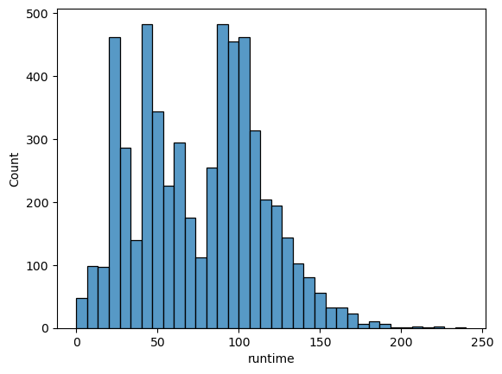
#9. Display the title of the movie with the least number of seasons.
10.Show the distribution of runtime.
Death note has the least number of seasons.
From the above graph we see that most of the movies have runtime between 90 -120.

Slide 10
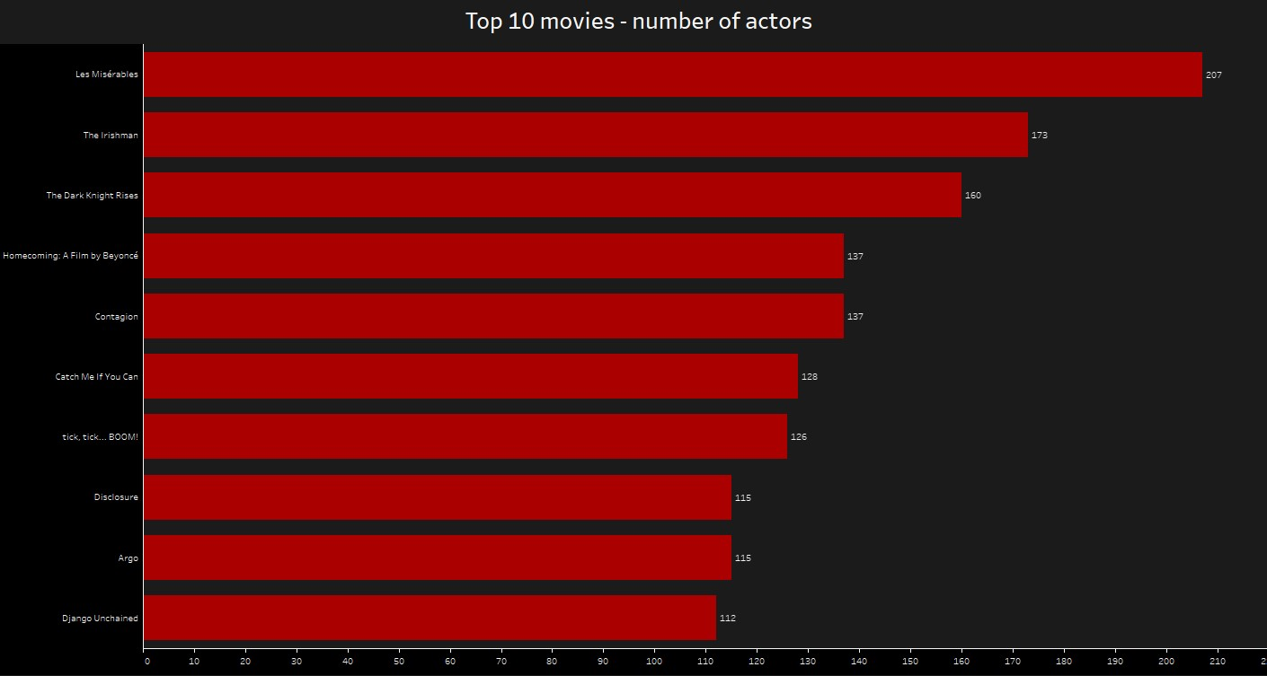
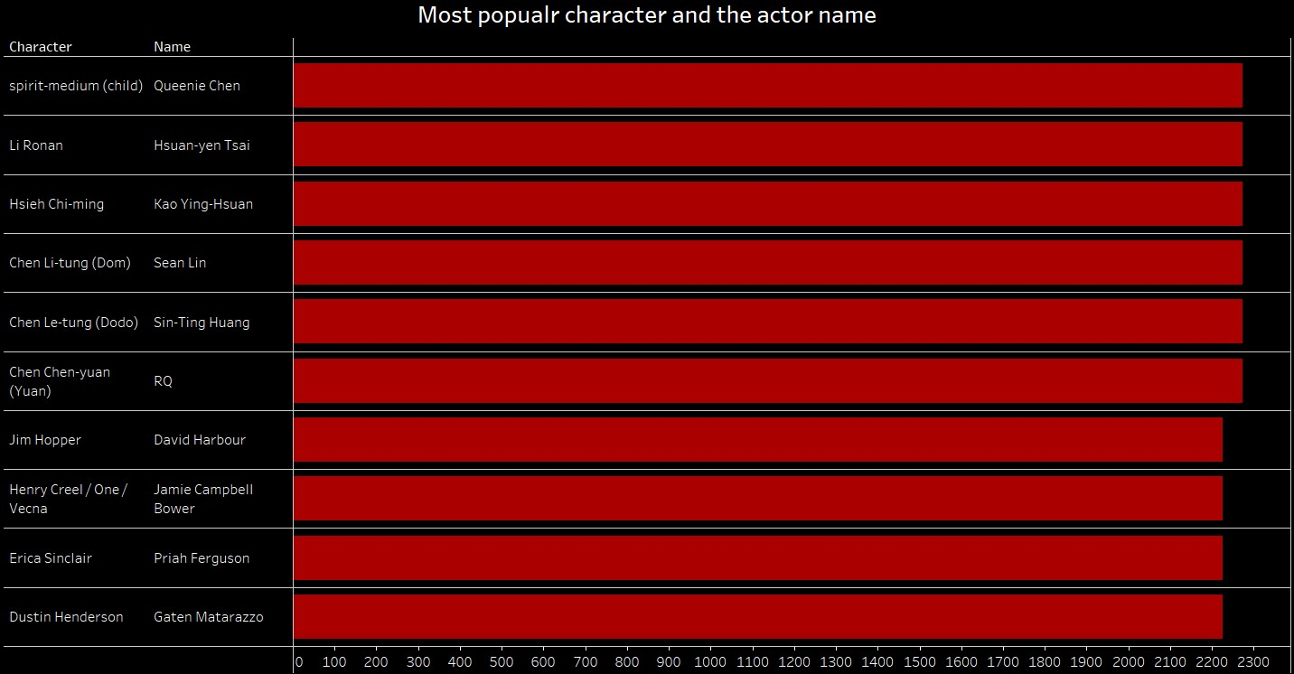


TABLEAU
Les Miserables has been found to be the highest among the top movies with respect to number of actors with having a total of 207 actors.
Spirit-medium(child) is the most popular
character played Queenie Chen.

Slide 11
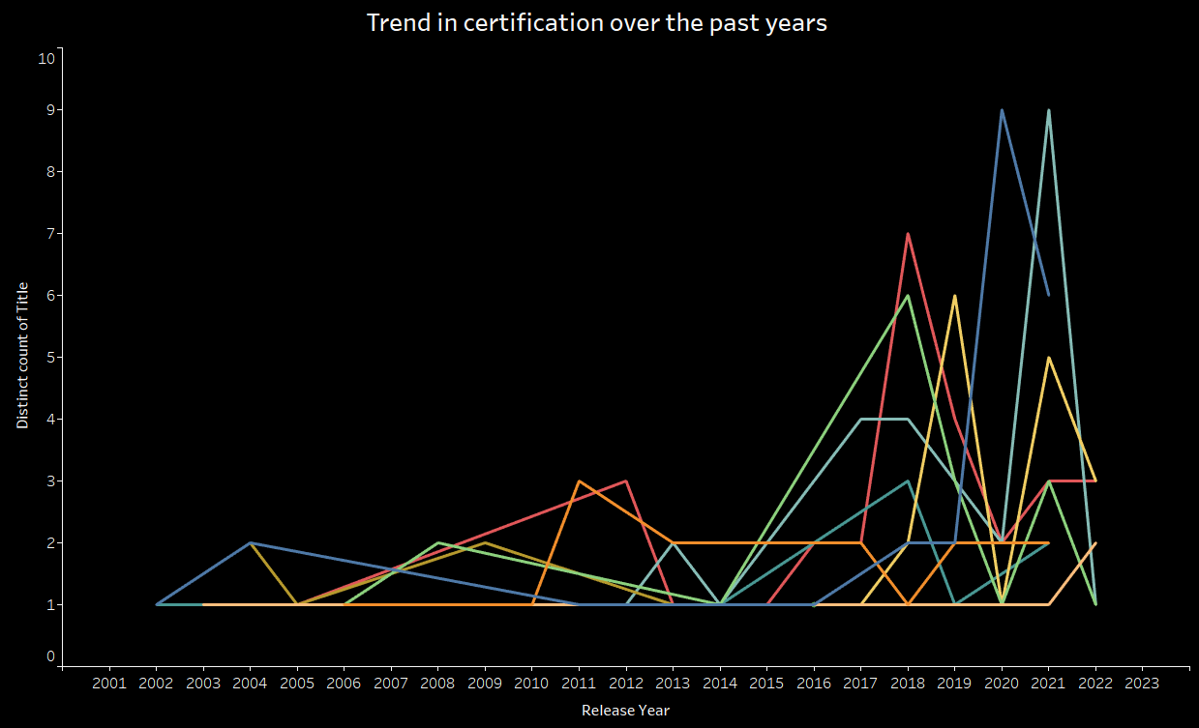
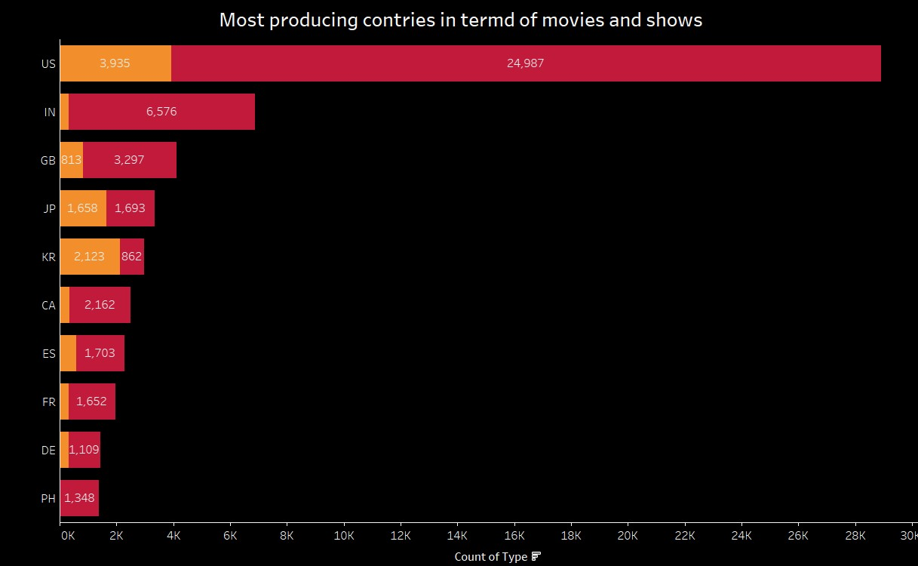
TABLEAU
From the following given trend we find the highest trend in certification over
the past years is in between 2019-2022.
US tops in both the most producing countries in terms of movies i.e.,24,987 and shows i.e.,3,953

Slide 12

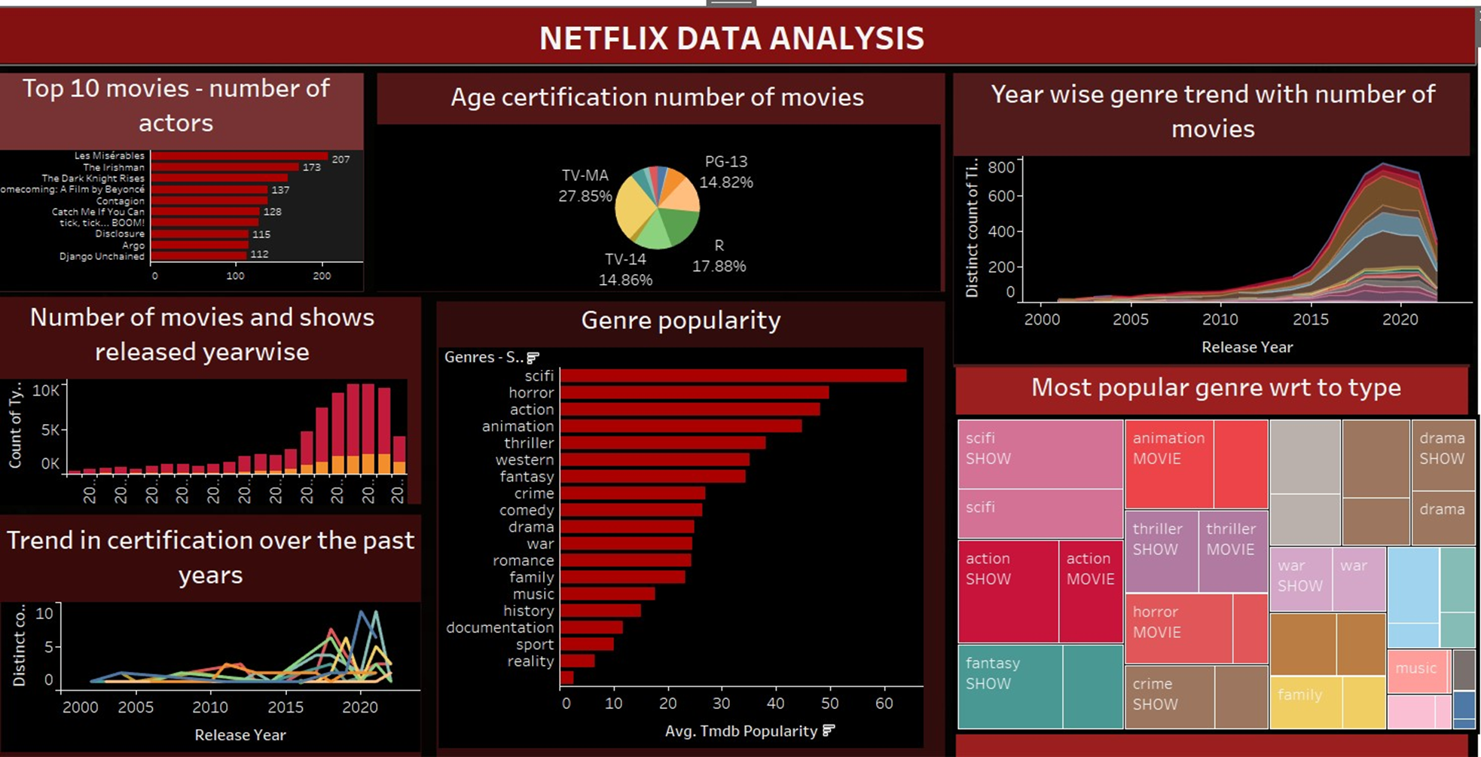
DASHBOARD

Slide 13
CONCLUSION
our project on Netflix data analytics, powered by Python and Tableau, delved into user preferences, content performance, and engagement metrics. The insights gained provide a strategic edge for decision-making in the dynamic streaming landscape, emphasizing the pivotal role of data analytics in shaping the future of digital entertainment.

Slide 14
THANKYOU

